Slide 1
Category - Aware Chronic Stress Detection on Microblogs
Guide Name:
Mrs. A. Durga Bhavani M.Tech.
Asst. Prof, Dept. of CSE
Team Details:
A. Saiteja Goud
A. Bhargavi Reddy
A. Sumith Kumar

Slide 2
ABSTRACT
People today live a stressful life. Compared with acute stress, long-term chronic stress is more harmful, and may cause or exacerbate many serious health problems, including high blood pressure, heart disease, chronic pain, and mental diseases. With social media becoming an integral part of our daily lives for information sharing and self-expression, detecting category-aware long-standing chronic stress from a large volume of historic open posts made by social media users is possible. In this study, we construct a data set containing chronically stressed users with open posts on Sina microblog, and design two techniques for category-aware chronic stress detection: (1) a stress-oriented word embedding on the basis of an existing pre-trained word embedding, aiming to strengthen the sensibility of stress related expressions for linguistic post analysis; (2) a multi-attention model with three layers (i.e., category-attention layer, posts self-attention layer, and category-specific post attention layer), aiming to capture inter-relevance from a sequence of posts and infer long-term stress categories and stress levels.

Slide 3
INTRODUCTION
We all experience stress in our lives. There are two kinds of stress: acute stress and chronic stress. Acute stress is short-term stress, and chronic stress is long-term stress. Examples of acute stress would be any stress we suffer from for a short period of time, e.g., a traffic jam, an argument with the partner, or criticism from the adviser. Acute stress is a normal part of everyday life, and helps our stress response system stay on ball. However, if we are repeatedly exposed to the same or many different stressors for a long period of time, we fall prey to the negative effects of chronic stress. Over time, chronic stress gradually increases our resting heart rate, blood pressure, breathing rate, and levels of muscle tension, and our body has to work harder to keep us functioning normally.

Slide 4
PROBLEM STATEMENT
Internet and social media usage is became part and parcel of today human life style. People always try to share their ideas and thoughts in social media by posting a status or comments to particular or current topic, sharing the day to day activities which help to identify whether the person is “Stressed” or “Not Stressed”. Tweet level emotion detection reflects the instant emotions expressed by a particular tweet which also reflect mental health disorder such as depression or post-traumatic stress disorder (PTSD), angry, happy moment, family problem , financial problem, relationships problem, Stress due to Covid pandemic situation, medicine and hospital unavailability. So with help of social media data it is easy to identify people mental health status by weekly, monthly. We can identify the stress of people due to particular situation like pandemic or oxygen unavailability. Identify the stress based on the geographic location, regional, national identity.

Slide 5
LITERATURE SURVEY
Sno | Title | Author | Methodology Used | Data Sets | Advantages of Existing system | Existing system gaps/ Limitations
1 | Stress and anxiety detection using facial cues from videos | G. Giannakakis, D. Manousos, F. Chiarugi | Support vector Regression | UNBC and the BOSPHORUS | This output is a transformed image or a report based on image analysis | Different individuals may react or express differently under stress, therefore it is difficult to discover a uniform pattern to characterize the stress emotion.

Slide 6
LITERATURE SURVEY
Sno | Title | Author | Methodology Used | Data Sets | Advantages of Existing system | Existing system gaps/ Limitations
2 | Effects of stress on heart rate complexity comparison between short-term and chronic stress | C. Scumbert, M. Lambertz | Estimation of correlation dimension via calculating correlation dimension via time series. | SWELL dataset | It is free of the susceptibility for violation of stationary assumptions to which the spectral analytic frequency domain methods are subjected | The current study did not assess the influence of respiratory indices other than respiratory frequency (such as respiratory depth and central respiratory drive) on the effects of interest

Slide 7
LITERATURE SURVEY
Sno | Title | Author | Methodology Used | Data Sets | Advantages of Existing system | Existing system gaps/ Limitations
4 | Mental stress Detection using Physiological Signals Based on Soft Computing Techniques | F. Mokhayeri M-R. Akbarzadeh-T | Fuzzy support Vector machines (FSVM) | DREAMER | Recognizing emotions and feelings using physiological signals is that these are unconscious responses of the human body | Lot of sensors are required like SHIMMER, which makes it expensive.

Slide 8
LITERATURE SURVEY
Sno | Title | Author | Methodology Used | Data Sets | Advantages of Existing system | Existing system gaps/ Limitations
5 | A survey of affective computing for stress detection: Evaluating technologies in stress detection for better health | Shalom Greene; Himanshu Thapliyal; Allison Caban- Holt | Sensor Technology for Stress Detection | FACET and CERT | Detection and recognition of emotional information and simulation of emotion in computational devices | Computations are done based on the toolkit. It shows different results for different tool kits.

Slide 9
LITERATURE SURVEY
Sno | Title | Author | Methodology Used | Data Sets | Advantages of Existing system | Existing system gaps/ Limitations
6 | Towards a microblog platform for sensing and easing adolescent psychological pressures | Yuanyuan Xue, Qi Li, D. Clifton | Aggregating pressures from a teenager’s tweets sequence. | Dreaddit | Integrating multiple sensor sources in stress detection is also interesting to explore. | Limited information or content.

Slide 10
LITERATURE SURVEY
Sno | Title | Author | Methodology Used | Data Sets | Advantages of Existing system | Existing system gaps/ Limitations
7 | Workflow for Affective Computing and Stress Recognition from Biosignals | Dialina Hazer, Lin Zhang | Affect Classification— machine learning using Support Vector Machine, Random Forest and k-Nearest Neighbor algorithms | MAC dataset | Psychophysiological signals have the valuable advantage as honest signal. | It is time consuming because we need to process the signal each and every time (J48 algorithm).

Slide 11
LITERATURE SURVEY
Sno | Title | Author | Methodology Used | Data Sets | Advantages of Existing system | Existing system gaps/ Limitations
8 | Measuring post-Traumatic stress disorder in twitter | G. Coppersmith, C. Harman | Graph model combined with Convolutional Neural Network. | Sina Weibo | Improve the detection performance (F1-score) by 6-9% over that of the state-of-art approaches. | Data in social networks is usually composed of sequential and inter-connected items from diverse sources and modalities, making it are actually cross-media data.

Slide 12
LITERATURE SURVEY
Sno | Title | Author | Methodology Used | Data Sets | Advantages of Existing system | Existing system gaps/ Limitations
9 | Predicting personality from Twitter. | J. Golbeck, C. Robles. | Gaussian Process and ZeroR. | Big Five Personality Inventory. | Many opportunities are opened for personalizing interfaces and information. | Only certain type of people react for questionnaire. .

Slide 13
LITERATURE SURVEY
Sno | Title | Author | Methodology Used | Data Sets | Advantages of Existing system | Existing system gaps/ Limitations
10 | Stress Detection through Speech Analysis using Machine Learning. | S. Vaikole | CNN (Convolutional Neural Network) and dense fully connected layer networks. | RAVDESS. | It is likely be extended to a better conceptual multimodal based approach to further increase the detection accuracy. | It is not easy to find a database that can be classified into stressed or unstressed conditions from the same speaker.

Slide 14
LITERATURE SURVEY
Sno | Title | Author | Methodology Used | Data Sets | Advantages of Existing system | Existing system gaps/ Limitations
11 | Category-Aware Chronic Stress detection on Microblogs | Lei Cao, Hujun Zhang | Multi-Attention model | Sina weibo | Captures inter-relationships from a sequence of users’ posts, aiming to infer users’ long-term category-specific stress levels. | It is time consuming because we need to process the signal each and every time.(J48 algorithm)

Slide 15

EXISTING SYSTEM
Work on stress detection in the present system is based on digital signal processing, which takes into account of galvanic skin reaction, blood volume, pupil dilation, and skin temperature. Other research on this topic relies on a variety of physiological signals and visual aspects (eye closure, head movement) to assess a person's stress levels while they are at work. These measures, on the other hand, are obtrusive and uncomfortable in practice. Every sensor reading is compared to a stress index, that is used to determine the amount of stress.

Slide 16
LIMITATIONS OF EXISTING SYSTEM
Different individuals may react or express differently under stress, therefore it is difficult to discover a uniform pattern to characterize the stress emotion.
Lot of sensors are required which are expensive.
It is time consuming because we need to process the signal each and every time.(J48 algorithm)

Slide 17
PROPOSED SYSTEM
We leverage social media for chronic stress detection based on the
following two considerations.
Firstly, social media have become an integral part of our daily lives. They provide interactive computer-mediated technologies that support the sharing of information, thoughts and expressions. The large volume of historic records posted by social media users enable us to sense their long-standing chronic stress.
Secondly, compared with the methods which utilize questionnaires or various physical sensors to monitor physiological signals, social media are non-contact, labor inexpensive, and mass reach. Especially, from users’ linguistic social media posts, we can learn specific stress categories.

Slide 18
AIMS AND OBJECTIVE
To find whether user Stressed and Not Stressed using Social Media Data.
Personalized stress management.
Prevention of chronic stress-related illnesses.

Slide 19
ADVANTAGES
The proposed multi-attention model equipped with the stress oriented word embedding can achieve high accuracy in detecting category-aware stress levels, high accuracy in detecting chronic stress levels and categories only.
A multi-attention model was further designed to capture inter-relationships from a sequence of users’ posts, aiming to infer users’ long-term category-specific stress levels.

Slide 20
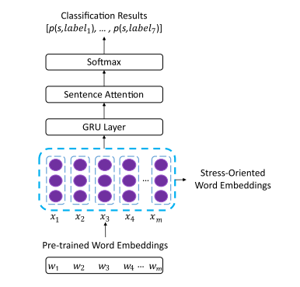
SYSTEM ARCHITECTURE

Slide 21
ALGORITHMS
Attention Model - MAM
BERT
LSTM

Slide 22
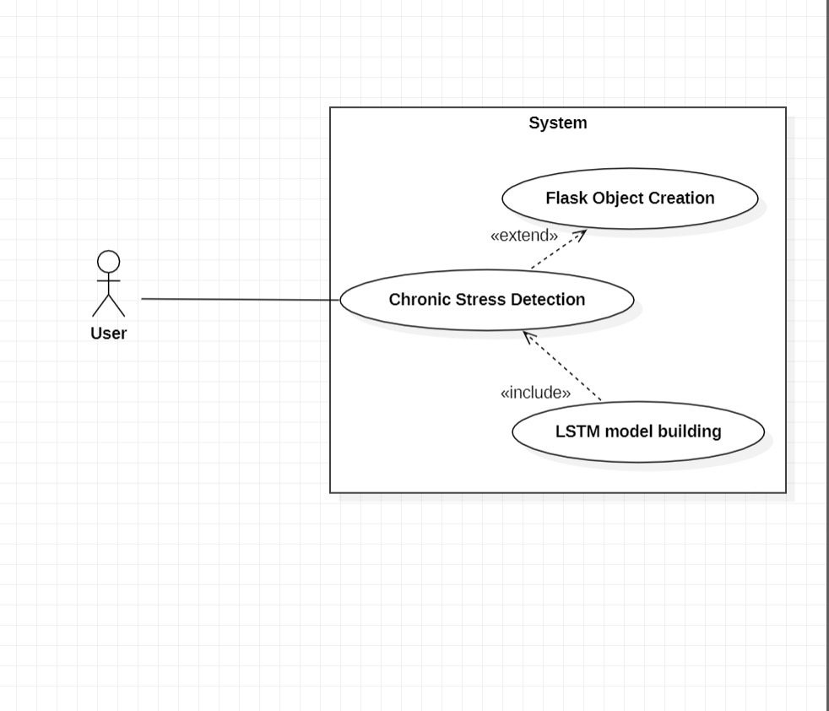
USECASE DIAGRAM

Slide 23
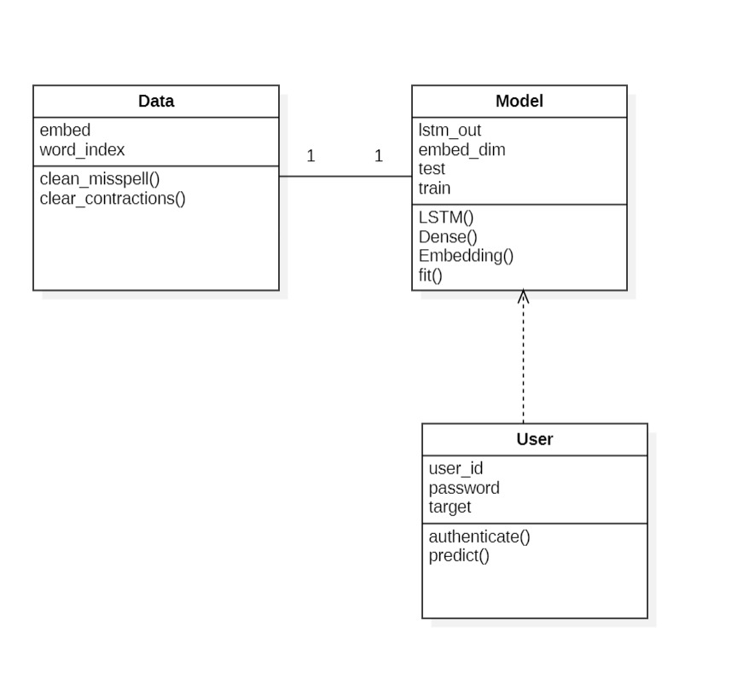
CLASS DIAGRAM

Slide 24
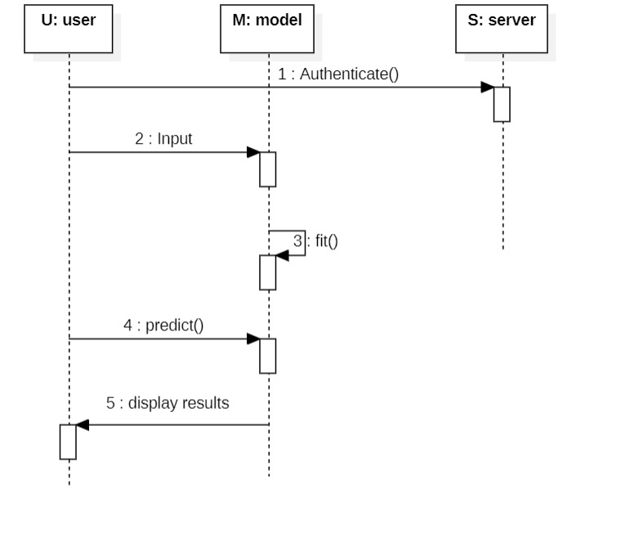
SEQUENCE DIAGRAM

Slide 25
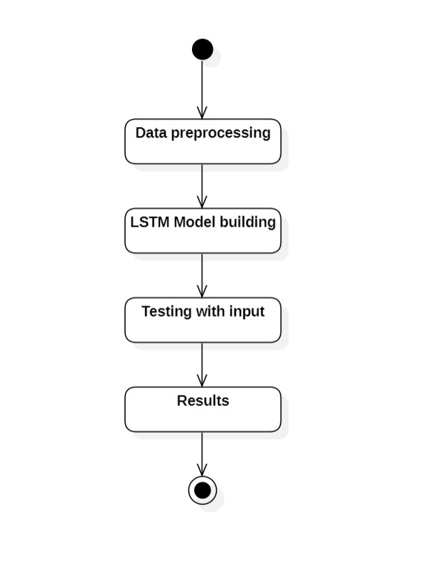
ACTIVITY DIAGRAM

Slide 26
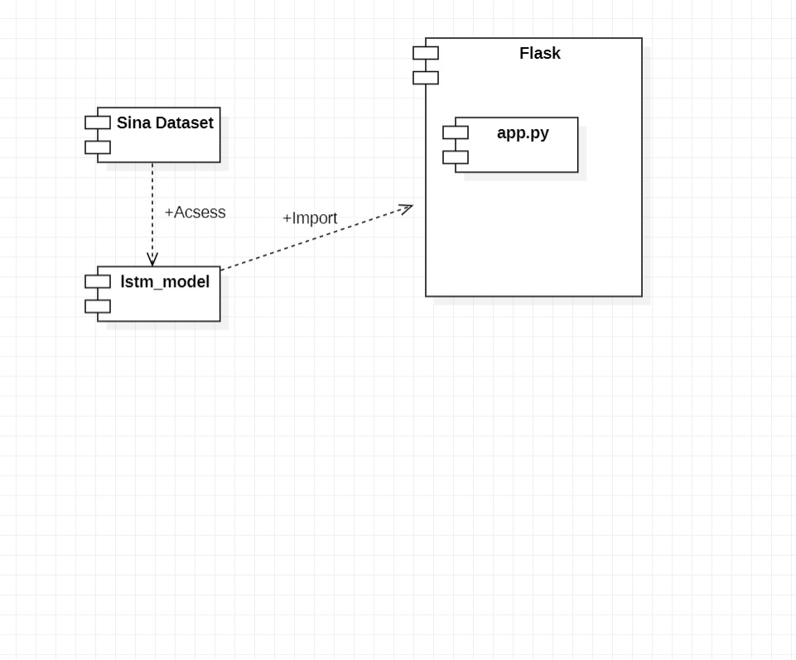
COMPONENT DIAGRAM

Slide 27
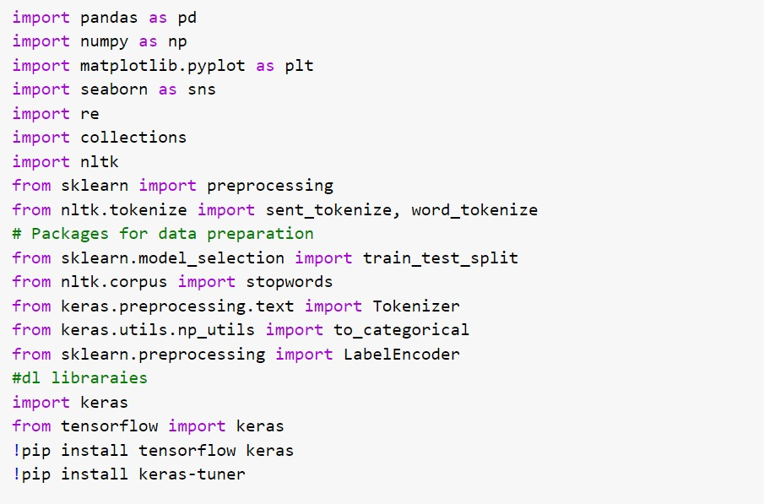
CODE

Slide 28
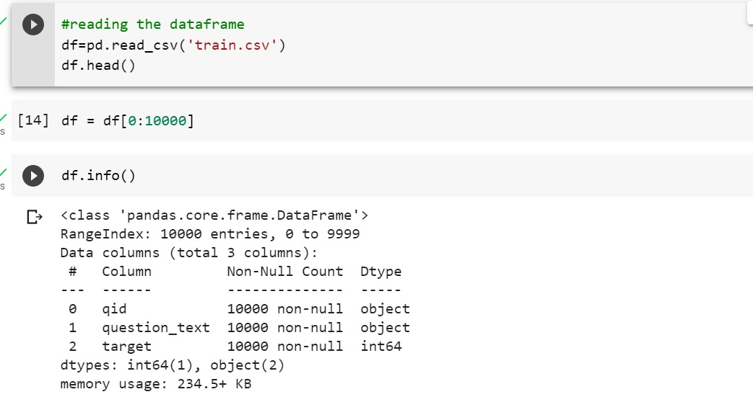

Slide 29
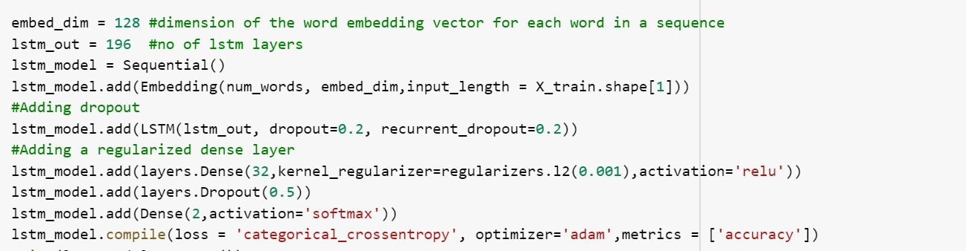
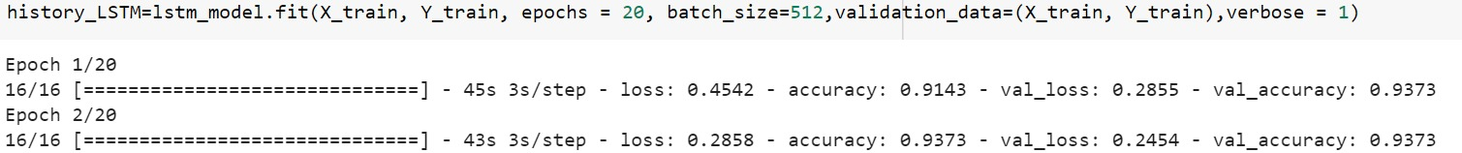

Slide 30
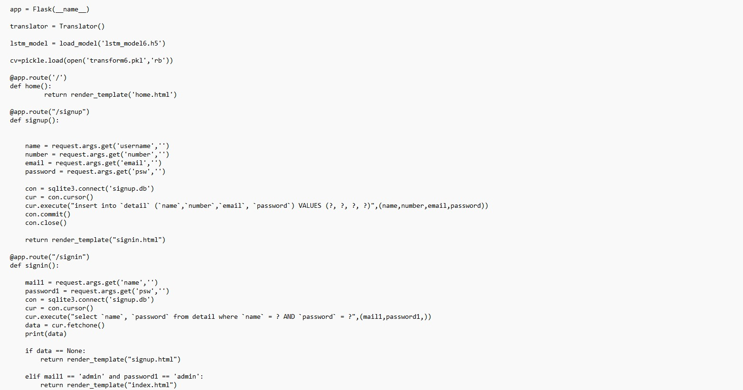

Slide 31
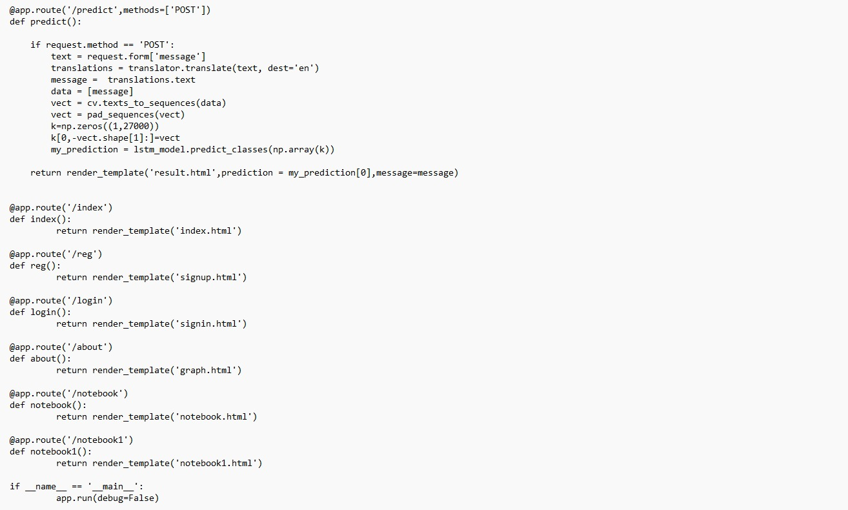

Slide 32
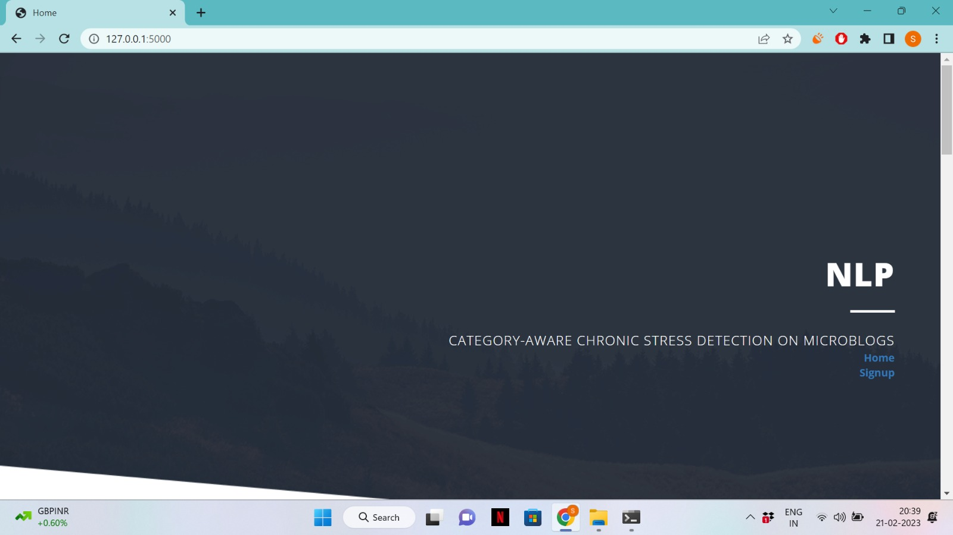
RESULTS

Slide 33


Slide 34
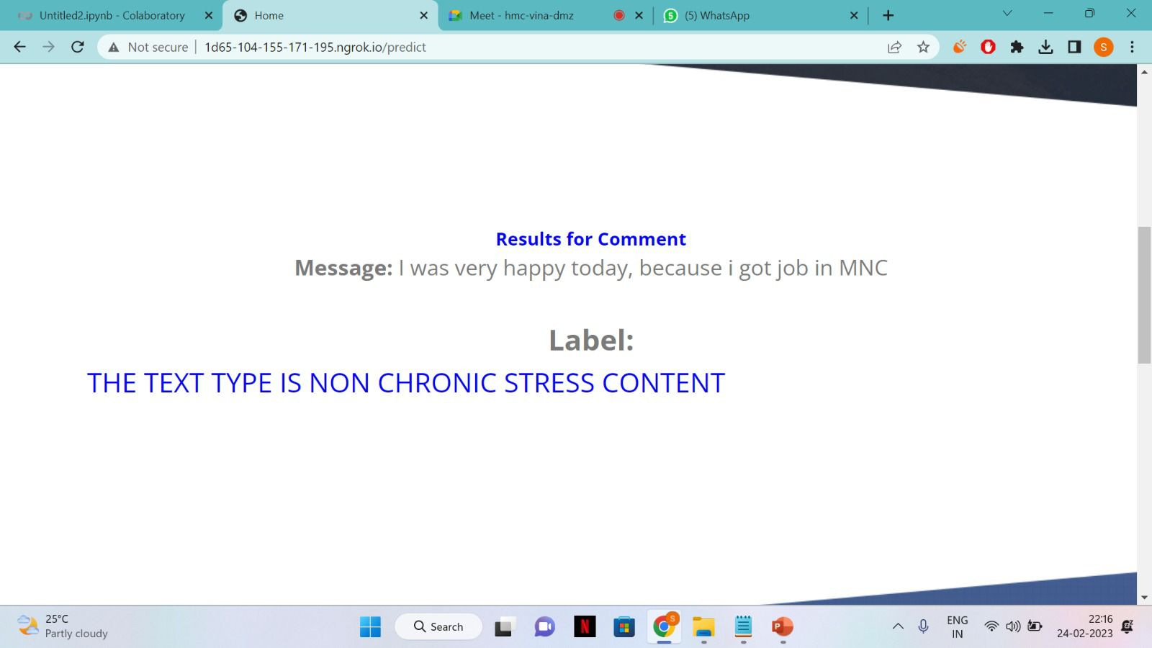

Slide 35
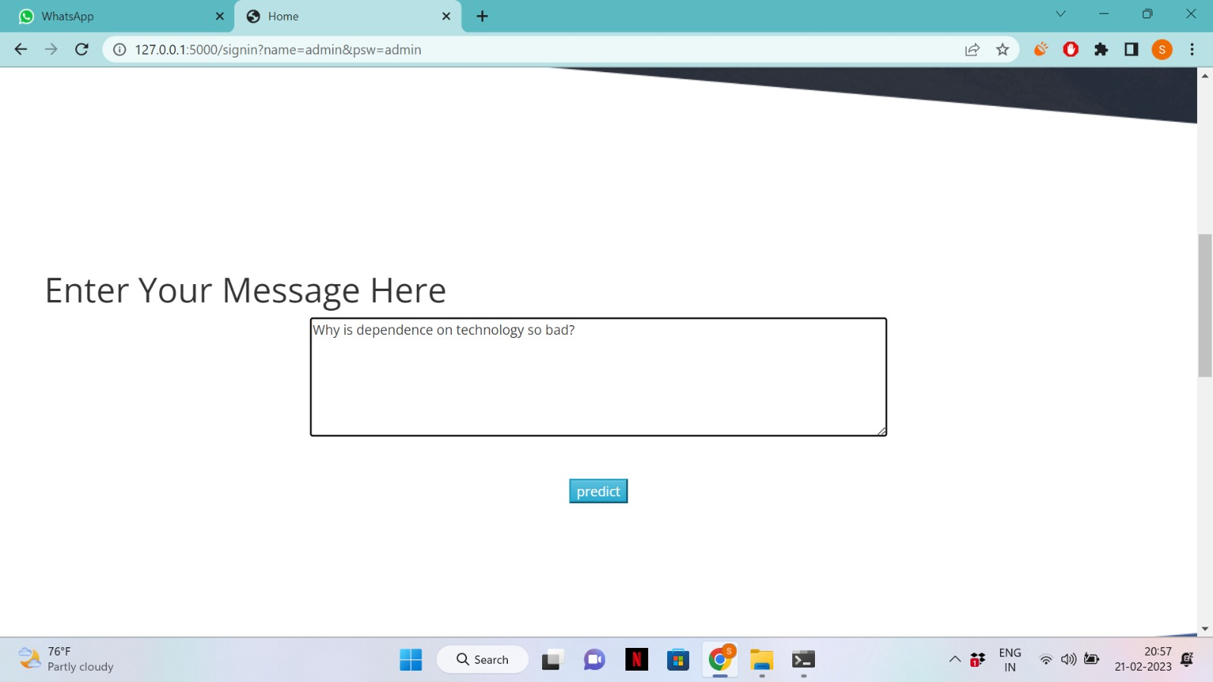

Slide 36
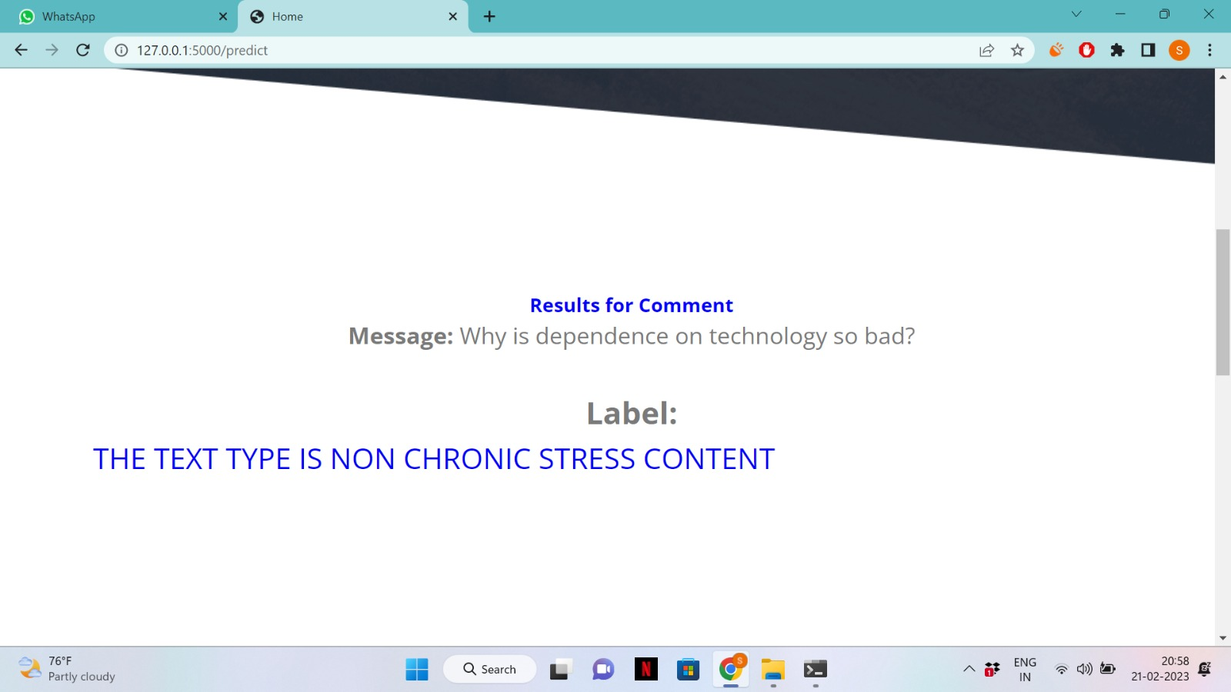

Slide 37
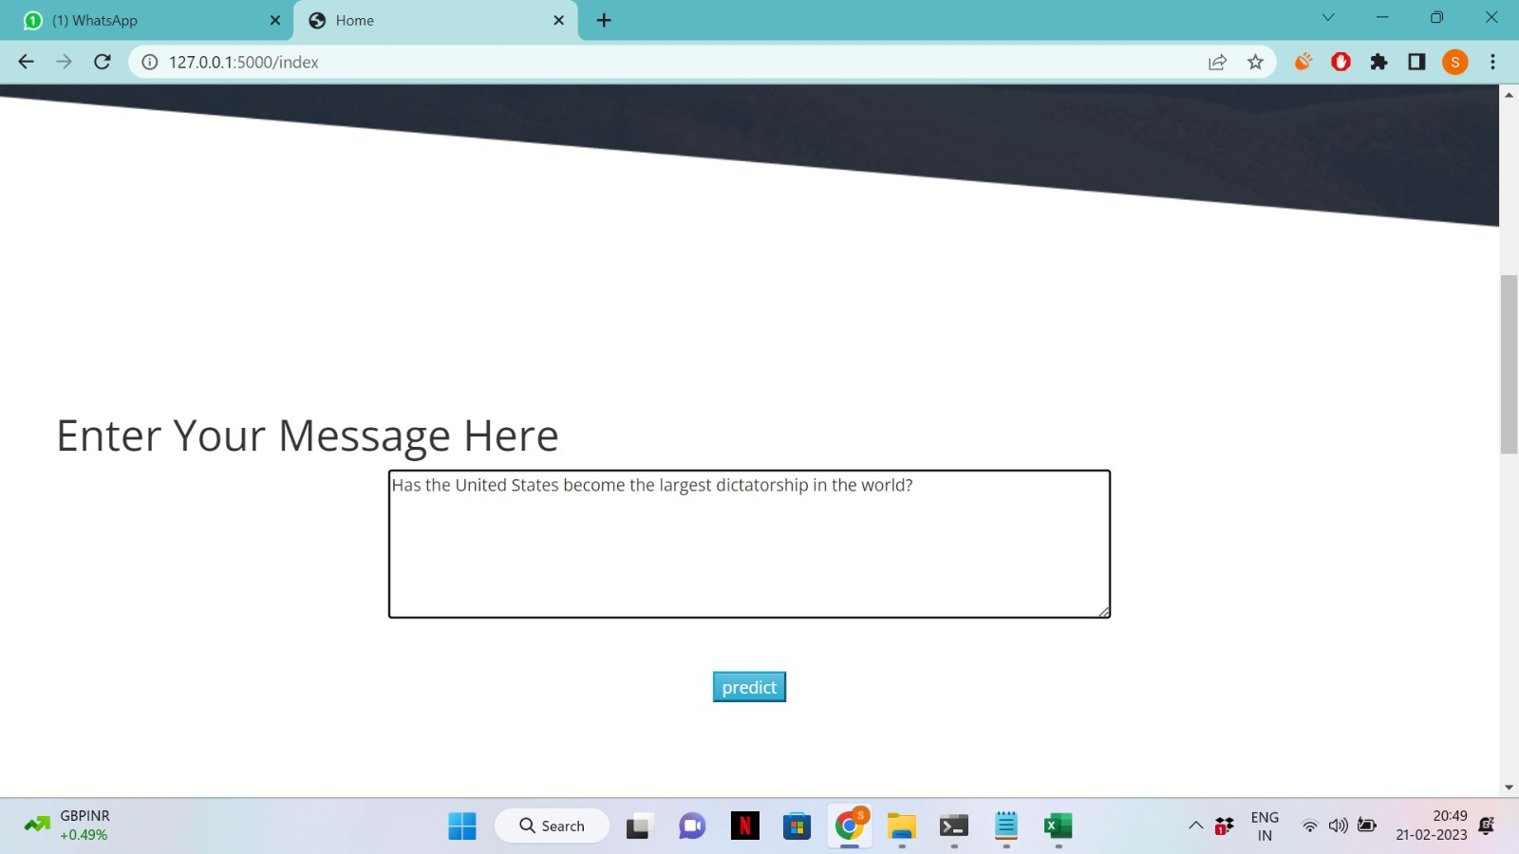

Slide 38
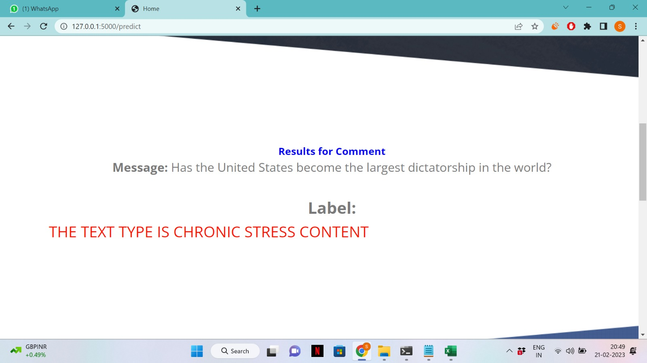

Slide 39
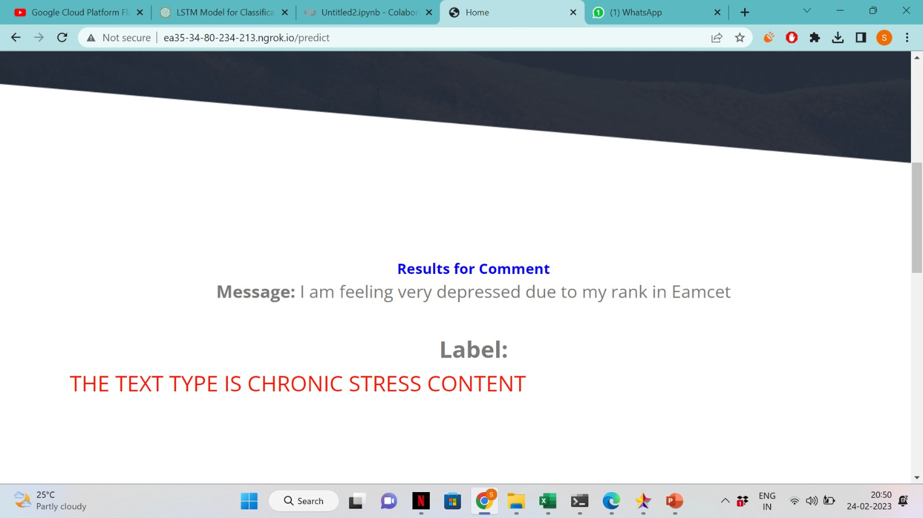

Slide 40
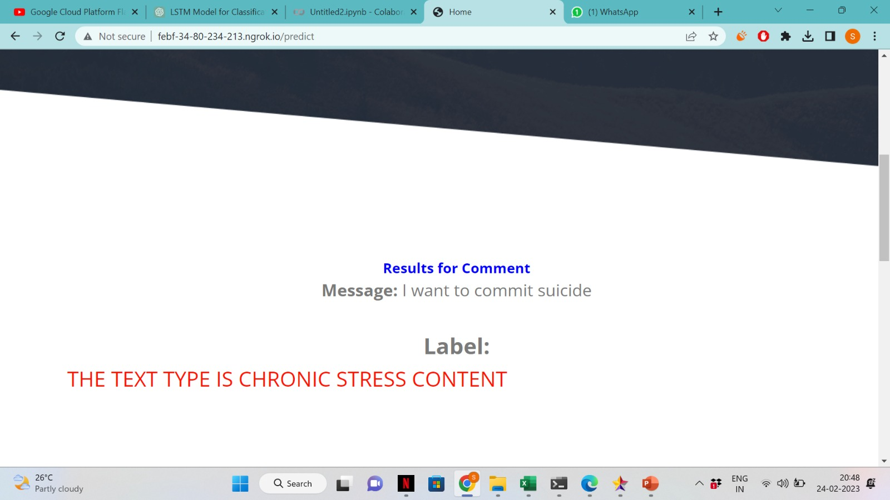

Slide 41
SCOPE
Chronic stress detection can have a wide range of applications in various fields, including healthcare, psychology, workplace safety, and education. Here are some examples of the scope of chronic stress detection:
Healthcare: Chronic stress detection can be used to identify patients who are at risk of developing stress-related disorders such as depression, anxiety, cardiovascular disease, and autoimmune disorders. This information can help healthcare professionals design personalized treatment plans for patients.
Psychology: Chronic stress detection can help psychologists and counselors identify individuals who are experiencing chronic stress and provide them with appropriate interventions to manage their stress levels.
Workplace safety: Chronic stress detection can help employers identify employees who are experiencing chronic stress and take steps to reduce stress levels in the workplace, such as implementing stress management programs, improving working conditions, and providing support to employees.
Education: Chronic stress detection can be used to identify students who are experiencing chronic stress and provide them with appropriate support, such as counseling and stress management programs, to improve their academic performance and overall well-being.

Slide 42
CONCLUSION
For social media-based category-aware chronic stress detection, we built a stress-oriented word embedding to strengthen the sensibility of stress-related expressions for linguistic post analysis. A multi-attention model was further designed to capture inter-relationships from a sequence of users’ posts, aiming to infer users’ long-term category-specific stress levels. By detecting the different categories of stressors that can lead to chronic stress, this approach can help identify individuals who are at risk of developing chronic stress before it becomes severe.

Slide 43
REFERENCES
[1] C. Schubert, M. Lambertz, R. Nelesen, W. Bardwell, J.-B. Choi, and J. Dimsdale, “Effects of stress on heart rate complexity-A comparison between short-term and chronic stress,” Biol. Psychol., vol. 80, no. 3, pp. 325–332, 2009.
[2] K. A. McGonagle and R. C. Kessler, “Chronic stress, acute stress, and depressive symptoms,” Amer. J. Community Psychol., vol. 18, no. 5, pp. 681–706, 1990.
[3] R. R. Baheti and S. Kinariwala, “A survey: Stress detection techniques,” Int. J. Appl. Evol. Comput., vol. 11, no. 1, pp. 28–33, 2020.
[4] S. Greene, H. Thapliyal, and A. Caban-Holt, “A survey of affective computing for stress detection: Evaluating technologies in stress detection for better health,” IEEE Consum. Electron. Mag., vol. 5, no. 4, pp. 44–56, Oct. 2016.
[5] Y. Xue, Q. Li, L. Feng, G. D. Clifford, and D. A. Clifton, “Towards a microblog platform for sensing and easing adolescent psychological pressures,” in Proc. ACM Conf. Pervasive Ubiquitous Comput. Adjunct Pub., 2013, pp. 215–218.
[6] Y. Xue, Q. Li, L. Jin, L. Feng, D. A. Clifton, and G. D. Clifford, “Detecting adolescent psychological pressures from micro-blog,” in Proc. Int. Conf. Health Inf. Sci. Cham: Springer, 2014, pp. 83–94.
[7] L. Zhao, Q. Li, Y. Xue, J. Jia, and L. Feng, “A systematic exploration of the micro-blog feature space for teens stress detection,” Health Inf. Sci. Syst., vol. 4, no. 1, pp. 1–12, 2016.
[8] N. Zhao, D. Jiao, S. Bai, and T. Zhu, “Evaluating the validity of simplified Chinese version of LIWC in detecting psychological expressions in short texts on social network services,” PLoS One, vol. 11, no. 6, 2016, Art no. e0157947.
[9] H. Lin et al., “User-level psychological stress detection from social media using deep neural network,” in Proc. 22nd ACM Int. Conf. Multimedia, 2014, pp. 507–516.
[10] M. Thelwall, “Tensistrength: Stress and relaxation magnitude detection for social media texts,” Inf. Process. Manage., vol. 53, no. 1, pp. 106–121, 2017

Slide 44
THANK YOU

